Slide 1
Introduction to Neural Networks
The Data Bootcamp

Slide 2
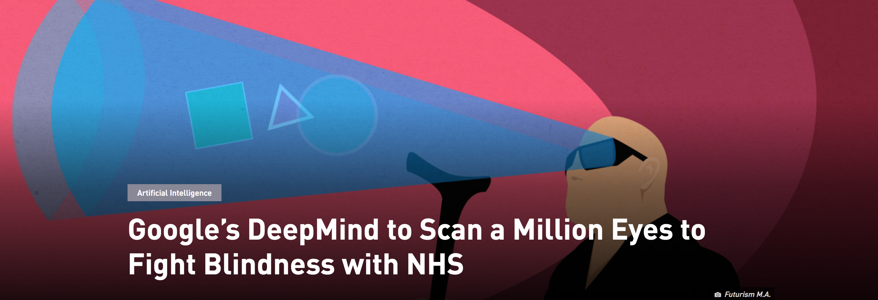
Blindness Detecting Neural Network
https://futurism.com/googles-deepmind-to-scan-millions-of-eyes-to-fight-blindness-with-nhs/

Slide 3
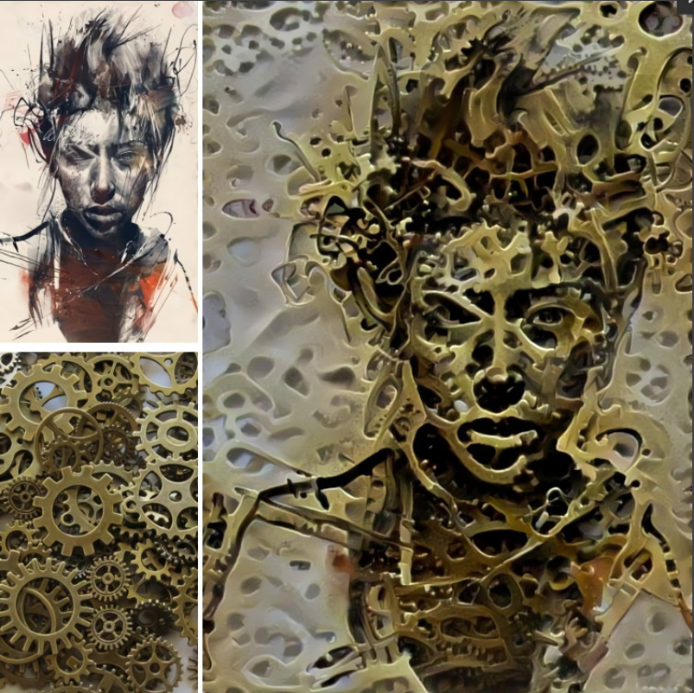
A Neural Network that merges the style of two images
https://deepdreamgenerator.com/#gallery

Slide 4
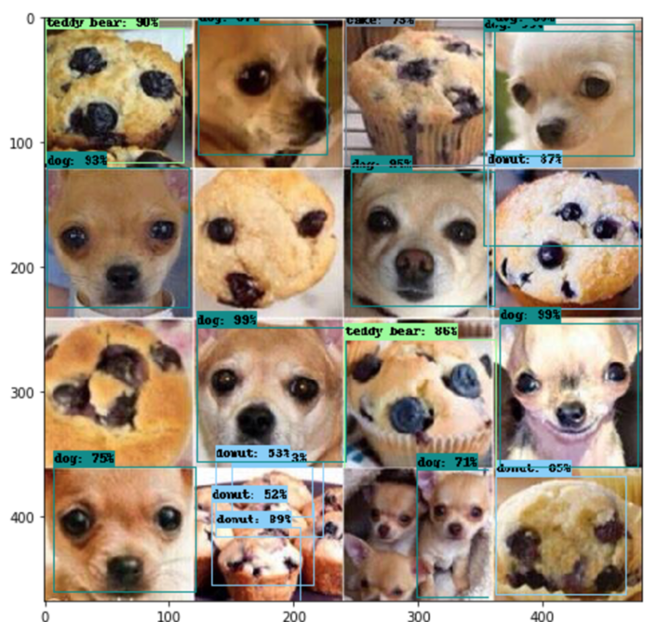
Muffin vs Dog Detector?
https://deepdreamgenerator.com/#gallery

Slide 5
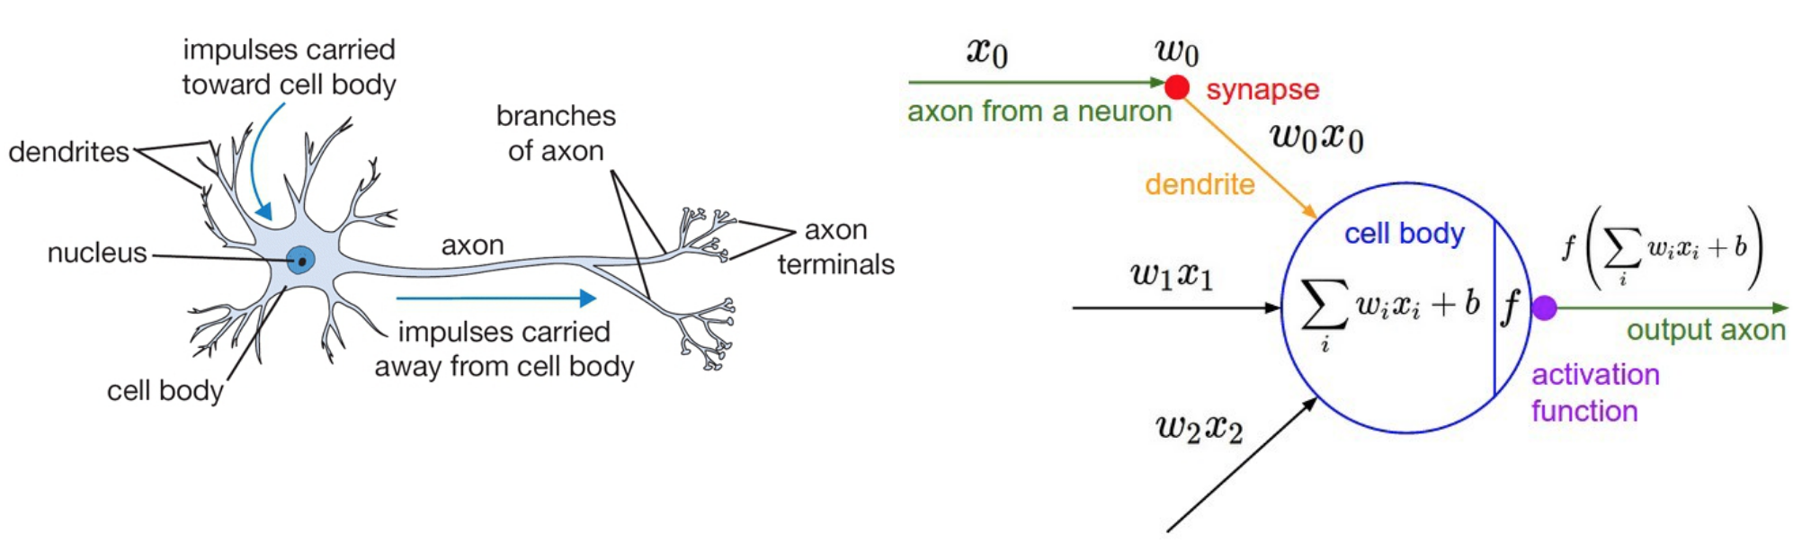
Artificial Neural Networks
If this is what comes to mind when you think "neural", you're on the right track.
The development of neural nets were inspired by the arrangement of neurons in the human brain.
The neuron's **axon** is what it uses to send signals to other neurons.
**Synapses** are sensors that receive signals from other neurons.

Slide 6

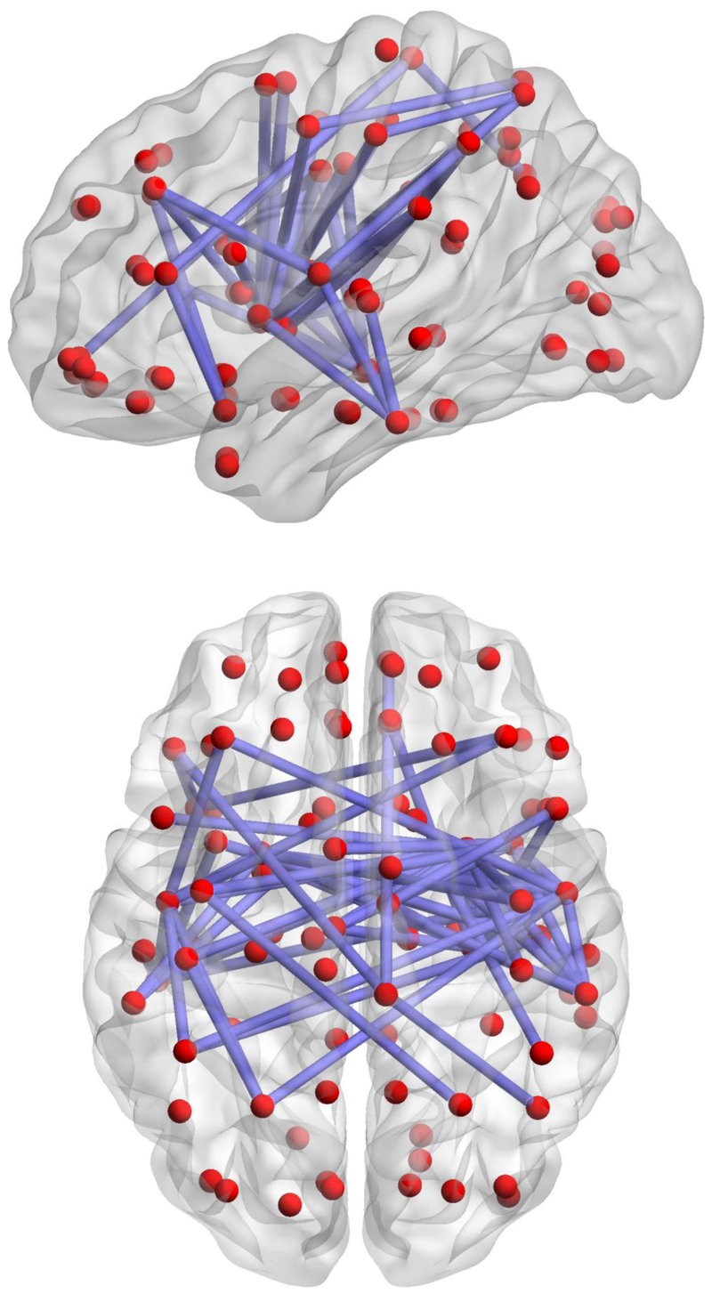
Artificial Neural Networks
The Brain
vs

Slide 7
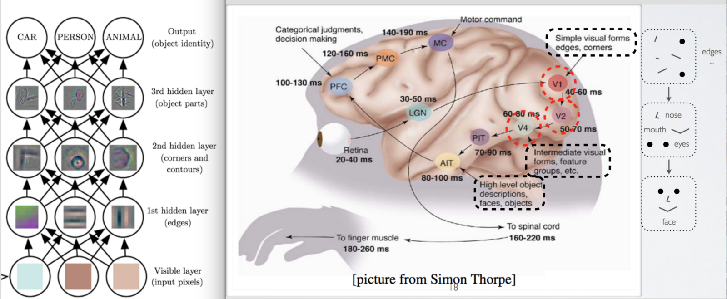
Artificial Neural Networks
As it turns out, the neural networks we program find patterns in inputs in much the same way the brain does.
As we'll see, if you understand how the brain processes visual information, you understand how neural nets process any information.

Slide 8
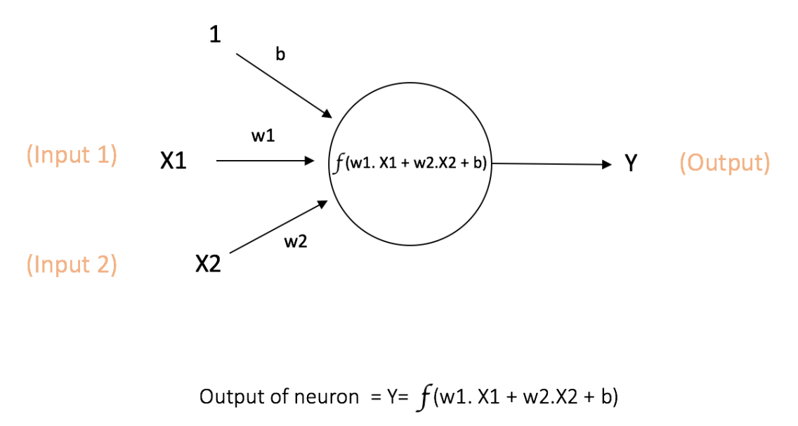
The Math...
Neurons are kinda/sorta similar to logistic regression

Slide 9
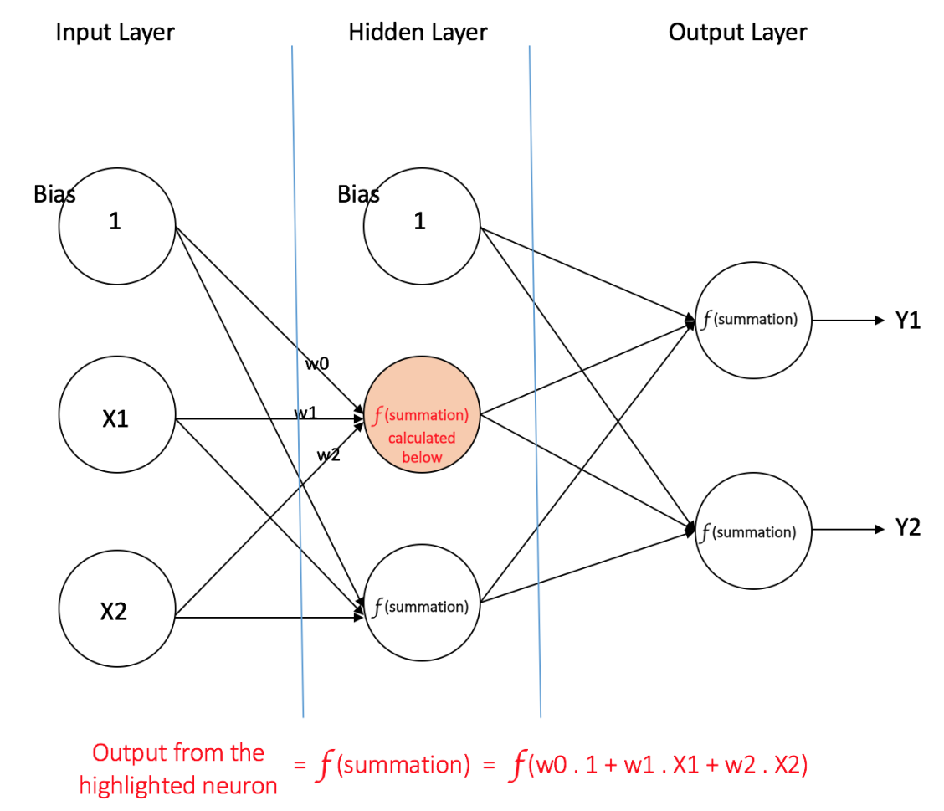
The Math...
Neural Networks are just layer of neurons connected together

Slide 10
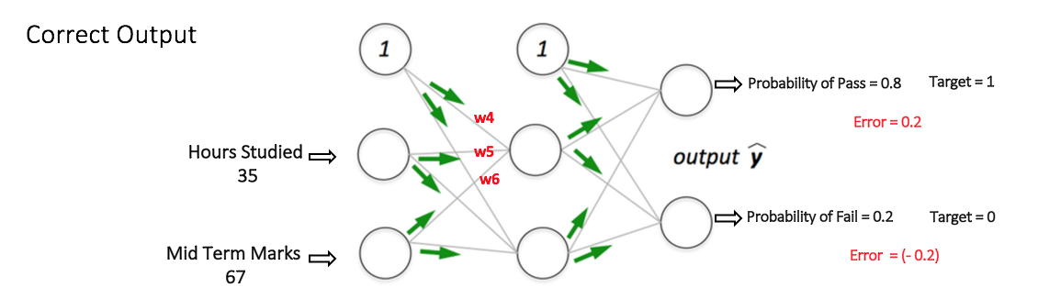
The Math...
The most important mathematical detail to understand is that neural networks typically output probabilities.
In other words, if we were to tell it how many hours we studied for a test, and our grade on the midterm, it will spit out a probability that we'll pass (or fail!...) the final.

Slide 11

How does it work?
Neural Networks are trained by feeding it (forward propagation) a bunch of inputs (like pictures of cats and dogs) and comparing the outputs to a known label (the output was a cat). The error in the output probability is then fed back (back propagation) to update the weights in each neuron. This is repeated until the NNet learns how to provide an accurate probability for a given input.

Slide 12
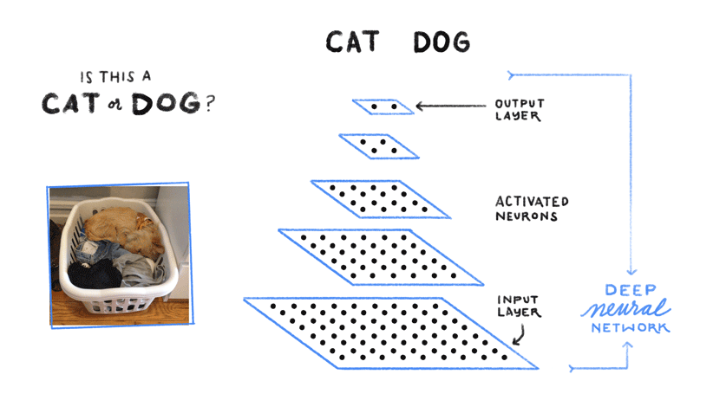
How does it work?
A trained neural network can take a new input (picture of a dog) and feed it through the network to predict the output label (cat or dog).
https://www.google.co.in/about/main/machine-learning-qa/

Slide 13
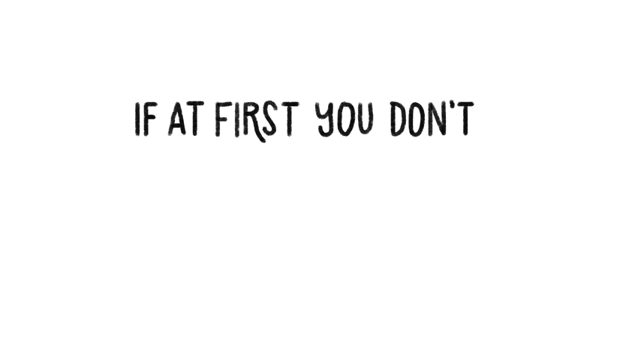
In a nutshell...

Slide 14
Questions / Discussion
Notes:
It’s important to keep in mind why you joined this class. Let’s talk about your goals.

Slide 15
Why Keras? Who keras?
The Data Bootcamp

Slide 16
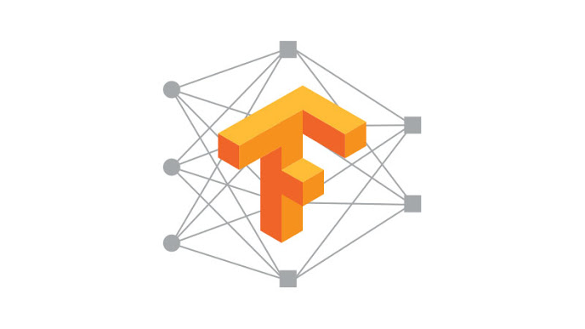
TensorFlow
Machine learning library
Use it to build neural networks
Runs on multiple platforms
...including distributed computing
Allows detailed fine-tuning

Slide 17

Keras
A layer of abstraction
Simplifies deep learning modeling
Allows rapid prototyping
Works on top of TensorFlow (among other libraries)

Slide 18
Keras + TensorFlow
Keras allows interaction with TensorFlow through a
simplified interface similar to Sklearn
Model -> Fit -> Predict (with a few other steps)

Slide 19
Installation
Notes:
It’s important to keep in mind why you joined this class. Let’s talk about your goals.

Slide 20
Installation
conda install tensorflow
import tensorflow.keras

Slide 21
Questions / Discussion
Notes:
It’s important to keep in mind why you joined this class. Let’s talk about your goals.

Slide 22
Kmeans
The Data Bootcamp

Slide 23
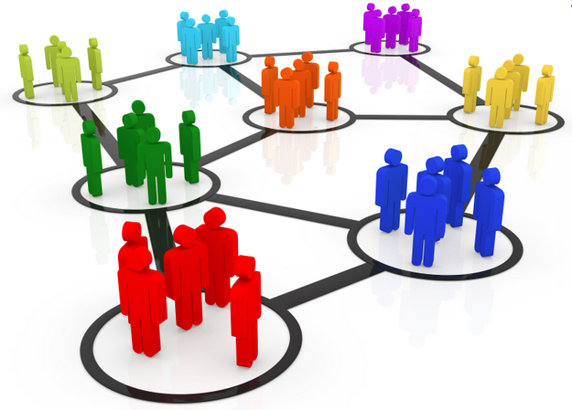
Unsupervised Learning
Unsupervised machine learning algorithms draw inferences directly from the data without any previously labeled outputs (i.e. no y labels).
One common type of unsupervised learning is cluster analysis. That is, the algorithms attempts to group that data into clusters based on relationships and features in the data.

Slide 24
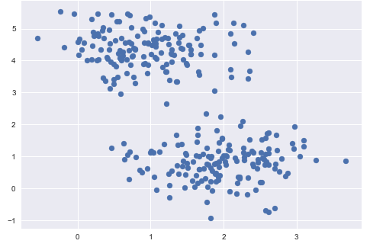
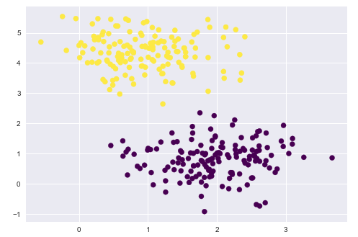
Clustering
While clustering may be intuitive to humans in this case, clustering algorithms have to decide which data points belong together.
Unclustered Data
Clustered Data

Slide 25
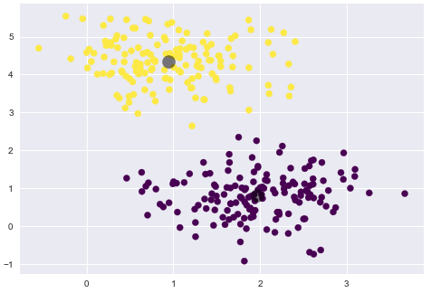
K Means
K means clustering will group the data into `k` groups.
The cluster center is the mean of all the points belonging to that cluster. Therefore each point is closer to it’s own cluster’s center than it is to other cluster centers.
Cluster
Centers

Slide 26
KMeans
K means clustering will group the data into `k` amount of groups.
A small k will create larger clusters.
K = 2

Slide 27
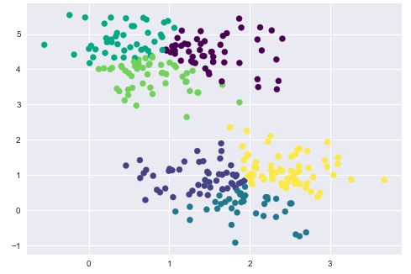
KMeans
A large k will create smaller clusters.
K = 6

Slide 28
Predictions using a trained KMeans model
What group would this new data point belong to?
Hi guys! Where do you want me?

Slide 29
Predictions using a trained KMeans model
Yellow Cluster Center
What group would this new data point belong to?
Hi guys! Where do you want me?
Purple Cluster Center

Slide 30
Predictions using a trained KMeans model
I had better use python to figure out which cluster center is the closest
np.sqrt(sum((x - y) ** 2))
Hmm, I could also figure this out using kmeans.predict(new_data)
Yellow Cluster Center
Purple Cluster Center

Slide 31
Predictions using a trained KMeans model
Purple is closer!

Slide 32
Questions / Discussion
Notes:
It’s important to keep in mind why you joined this class. Let’s talk about your goals.

